Slide 1


Slide 2
Spark Storage Overview
Spark Storage Options:
Memory (RAM): Spark stores data in memory for fast access and processing. Ideal for iterative algorithms and large datasets.
Disk Storage: For data that doesn’t fit in memory or needs to be persisted beyond a single job.
External Storage: Integration with external storage systems like HDFS, S3, and Azure Blob Storage.
Example:
In-memory Storage: Spark DataFrame cached using .cache() method.
Disk Storage: Using .persist(StorageLevel.DISK_ONLY) for datasets that do not fit in memory.

Slide 3
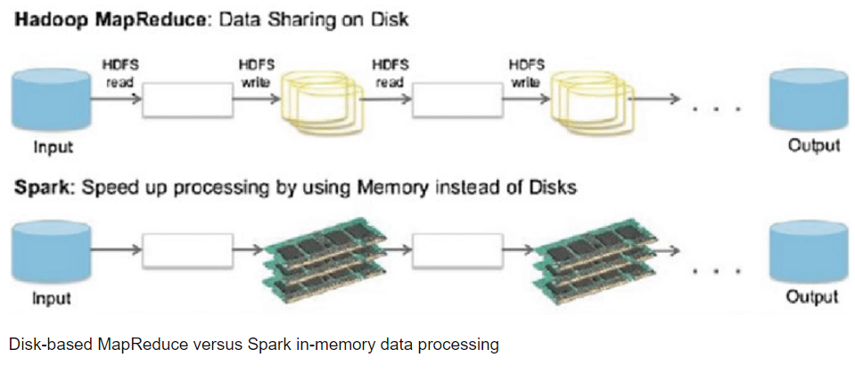

Slide 4
Supported Data Formats
Common Formats:
CSV (Comma-Separated Values): Simple text format for tabular data.
Example: spark.read.csv("data.csv")
JSON (JavaScript Object Notation): Hierarchical data format.
Example: spark.read.json("data.json")
Parquet: Columnar storage format optimized for Spark.
Example: spark.read.parquet("data.parquet")
ORC (Optimized Row Columnar): Another columnar format, often used with Hive.
Example: spark.read.orc("data.orc")
Specialized Formats:
Delta Lake: ACID transactions on data lakes.
Example: spark.read.format("delta").load("path/to/delta_table")
Avro: Binary format for row-based data.
Example: spark.read.format("avro").load("data.avro")

Slide 5
Choosing the Right Format and Storage
Factors to Consider:
Performance: Columnar formats (Parquet, ORC) offer better performance for analytical queries.
Compatibility: Choose formats based on integration needs (e.g., Delta Lake for ACID transactions).
Cost and Storage Efficiency: Evaluate storage costs and efficiency for large datasets.
Example Use Cases:
Data Warehousing: Use Parquet or ORC for large-scale analytics.
Streaming Data: JSON for real-time logs, Delta Lake for transactional data.

Slide 6
https://sparkbyexamples.com/

Slide 7


